Slide 1


Slide 2

POORNIMA INSTITUTE OF ENGINEERING &TECHNOLOGY JAIPUR
DEPARTMENT OF COMPUTER SCIENCE
INDUSTRIAL TRAINING PRESENTATION
ON
PYTHON BASIC
Prsented by - Ishu kumar Guided by - Department of CS
Reg no - piet20cs080
Year - 2nd

Slide 3

I give my credit to
Nandani sharma.

Slide 4
COURSERA
In 2012, coursera founder Koller built a software for a living virtual classroom Coursera is a global online learning platform that offers anyone, anywhere, access to online courses and degrees from leading universities and companies

Slide 5
MY PROJECT IS
Web browser .
In which I have named my browser a doreamon browser.

Slide 6
IMPORTANTS MARKS
PROJECT TYTLE
PROJECT OBJECTIVE
PROJECT TECHNOLOGY
Doreamon Browser.
To make a fast and safe browser and which generally focoused in your pravicy policy.
It is based on python.

Slide 7
PROJECT OUTCOME
The main purpurse of making this projects is to making it fast and secure search engion.
It is application software for accessing the World Wide Web. When a user follows the URL of a web page from a particular website .
Web browsers are used on a range of devices, including desktops, laptops, tablets, and smartphones but my project is fully desktop mode.

Slide 8
FUTHER PLANE OF THIS PROJECT
Firstely I have learn python clearly and than I have focoused on this project .
now I have focous of on my coding .

Slide 9
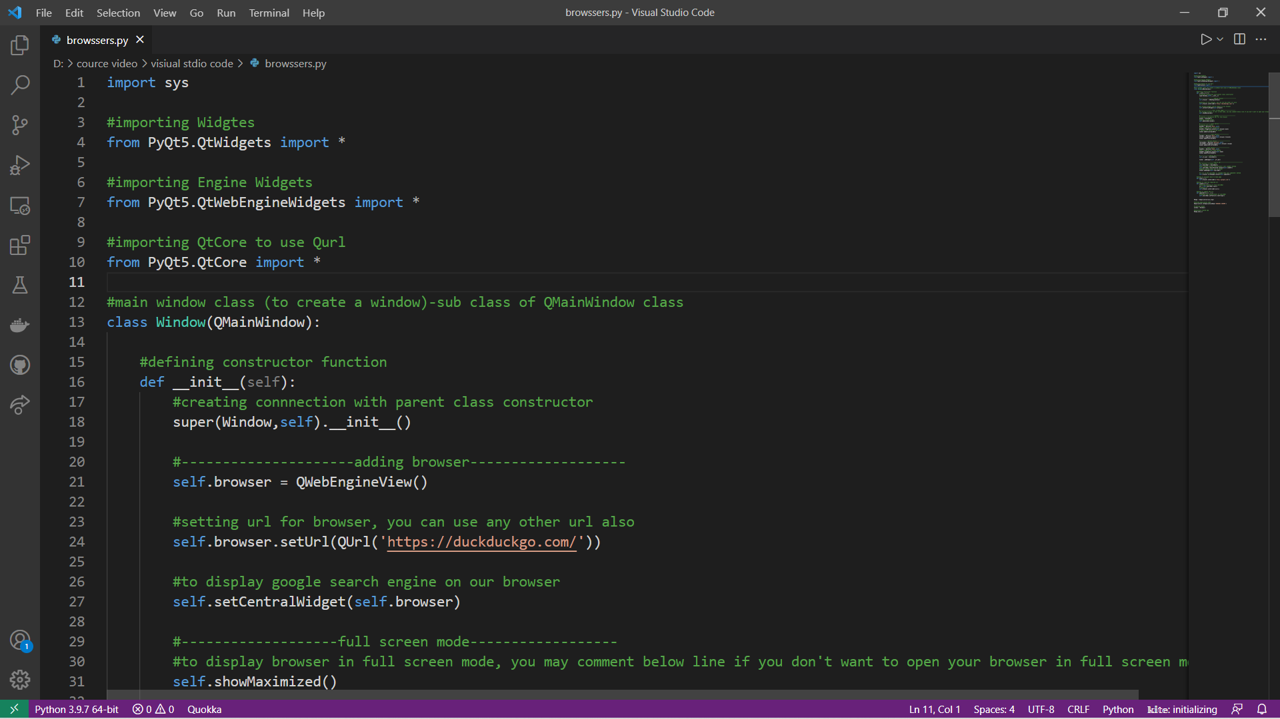

Slide 10
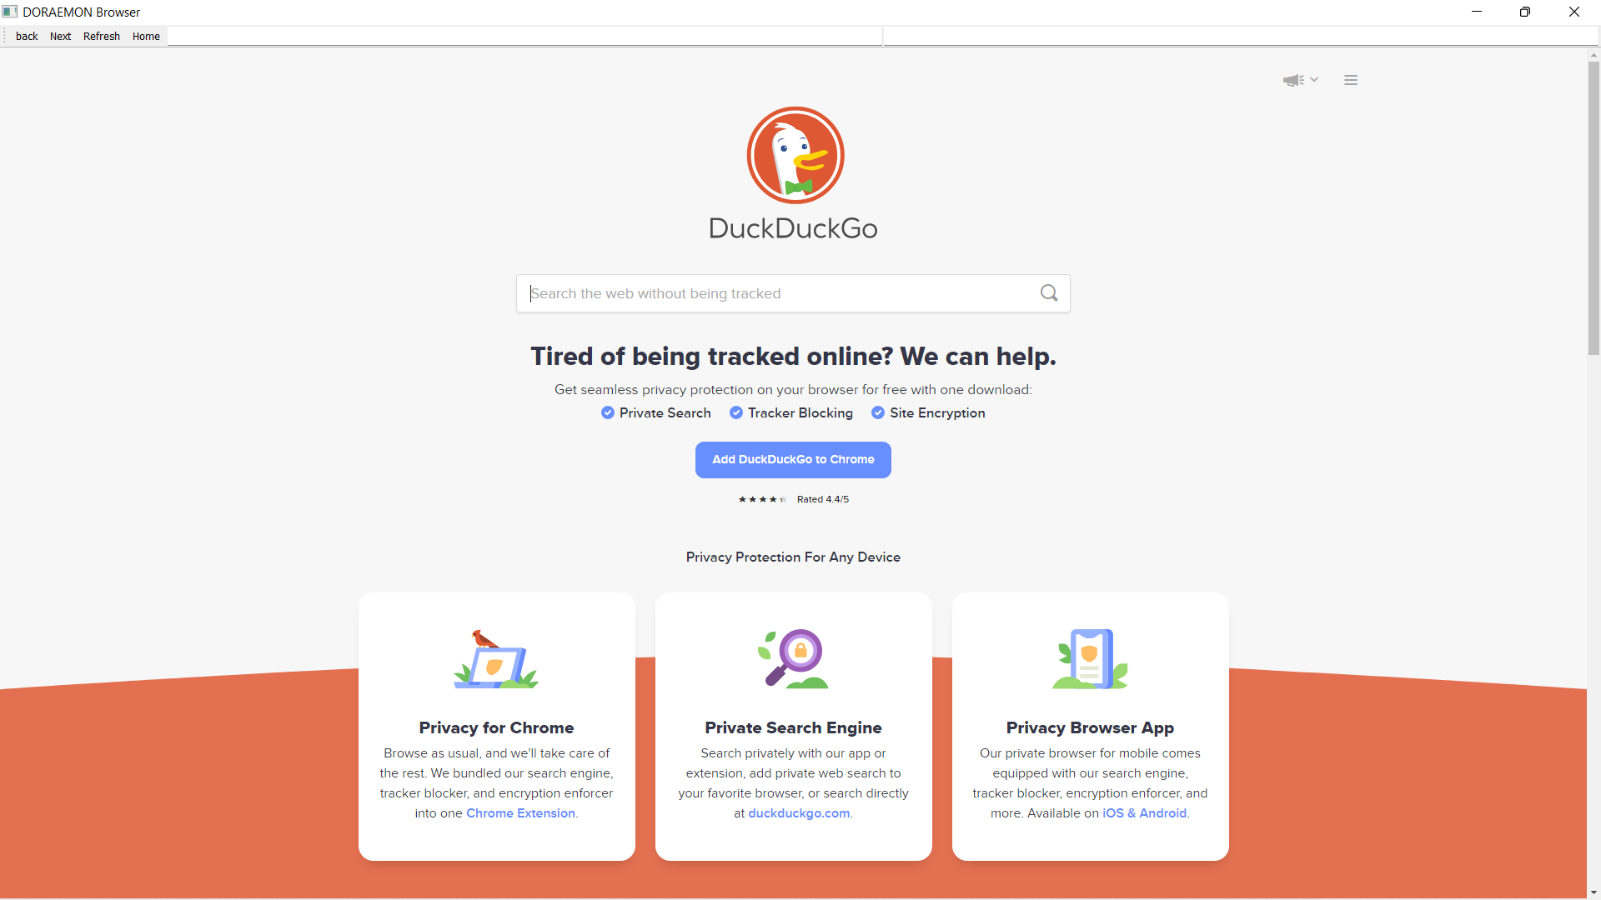

Slide 11
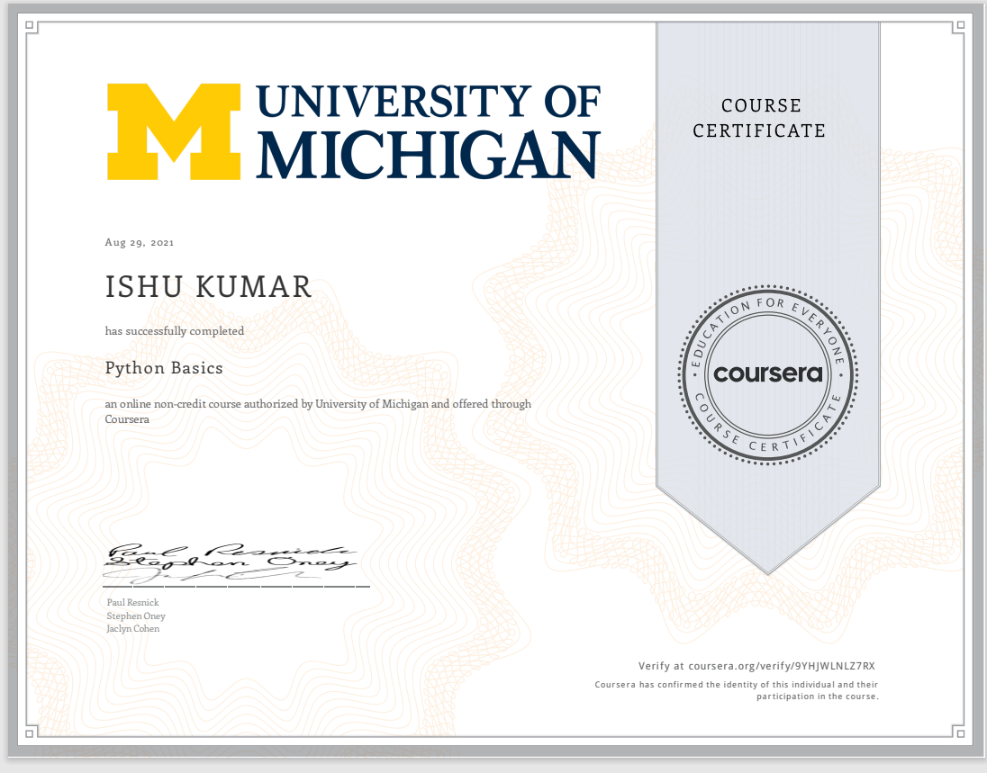
DIGITAL CERTIFICATE

Slide 12


